Slide 1
Master Files: Products, Price List, Currencies, Relationship Types Notes: Permissions are required for complete access to all features described herein. Before you start to create products, define the product classes that you want to use to classify them in Value Lists. Do not confuse Master Files with Design Master Templates (Term/Clause/Contract/…).
January, 2013

Slide 2
Product/Price
The classes of objects that provide price and product data are:
Product. It represents the one or more deliverables including services that you sell or purchase for a given price, according to a price list. A product can consist of a single deliverable such as a license, or a bundle of multiple deliverables such as a license and support agreement sold at a single price. A product can have many different prices associated with it, although each product can only be represented once in a given price list. Certain attributes of a product determine how it is renewed, such as if default renewal terms generate or a replacement product is used. Products are classified by product class.
Price List. It represents a list of price values that you apply to specified products. Price lists are classified by a variety of factors such as currency and whether used for buy or sell purposes. You sell or purchase by a list price and optionally apply a discount. Multiple price lists for the same product line may be required based on geographical region or customer type, for example. A price list can contain prices for many products; however, each unique product can only be represented once within a given price list.
Price. It represents the value amount that you apply to a product within a price list. Prices can be fixed, tiered (quantity-based), or based on a percentage of the price of another line in the contract. Several prices comprise a price list, and each product may have several prices associated with it across multiple price lists.
Administer Products and Price Lists via Administration → Master Files

Slide 3
Products
You use the Products feature to administer the products that you buy and sell. You can associate product objects to lines of a contract in order to supply certain values to those lines.
Within each product, you can define certain defaults that apply to renewal terms in a sales agreement.
Once you define products, you can associate them each with a price within one or more price lists.

Slide 4
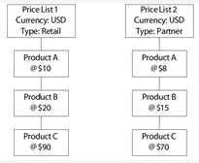
Price List
You use the Price Lists feature to manage the IBM Emptoris Customer’s price lists that you use to define lines within contracts. You can set up different price lists for your various markets and geographic areas.
Before you create price lists, define the price list classes you want to use to classify them.
In order to create prices contained within price lists, you need to first create the products you want to price.
Lines may contain certain fields that look up information from Master Files in Administration such as from the Price Lists and Products features.
The figure represents how price lists, prices, and products relate to one another and how you can use them in line fields that look up their values.

Slide 5
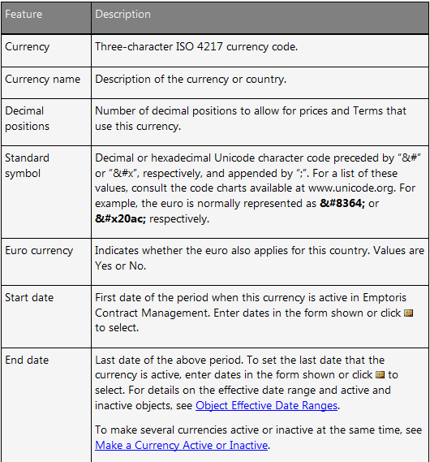
Currencies
Currencies are associated with internal organizations, contracts, price lists, and prices. The internal party organization of a contract determines the default currency applied to it. The organization of the user who creates a price list (or nearest parent thereof with a currency defined) determines the default currency applied to it. The currency of a price list determines the currency of its prices. The currency of a price list must match the currency of the contract for which it is selected.
Administration is via Administration → Master Files → Currencies

Slide 6
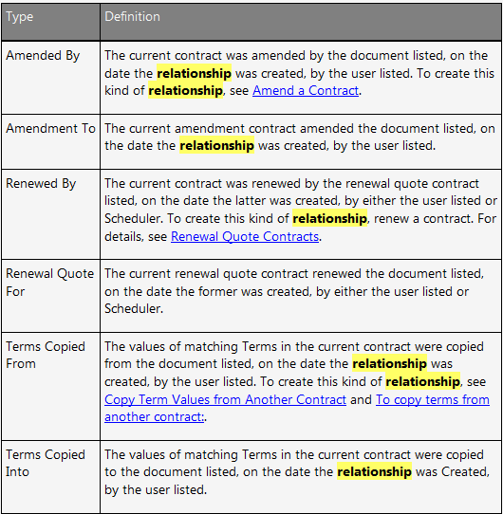
Relationship Types
Relationships are either system-generated or user-defined. System relationships are created by IBM Emptoris Contract Management in response to an action. System relationships are listed in the figure below.
User-defined relationships are first defined in the Relationship Types feature in Administration.
The purpose of each user-defined relationship type is determined by the IBM Emptoris Customer. Once a new relationship type exists, you can use it to apply a new user-defined relationship between any two contracts that you have permission to Read.
Administration is via Administration → Master Files
→ Relationship Types

Slide 7
Questions?

